Slide 1


Hii,
Iam Siddhika
Welcome to Power BI Series
Part -44

Slide 2



Today Content
We focus only on the most used and important Dax Functions
I’m soo Excited.
Are you ready guys?
Meet DAX
COMMON FUNCTION CATEGORIES 6.DATE AND TIME FUNCTIONS(FEW MORE) DAY
HOUR TODAY NOW

Slide 3

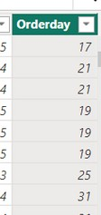


DAY
The DAY function in DAX extracts the day of the month from a date value. It returns an integer representing the day.
Check this
Syntax
DAY(<date>)
Example
Assume you have a table named Orders with the following columns:
OrderID: The unique identifier for each order.
OrderDate: The date the order was placed.
You want to extract the day of the month from the OrderDate.
Orders[OrderDate]: The column from which the day is extracted.
DAY function extracts the day from the date.

Slide 4

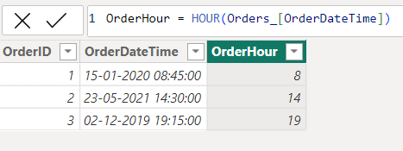

HOUR
The HOUR function in DAX extracts the hour from a date-time value. It returns an integer representing the hour.
Easy?
Syntax
HOUR(<datetime>)
Example
Here just i’m taking for example to understand.
Assume you have a table named Orders with the following columns:
OrderID: The unique identifier for each order.
OrderDateTime: The date and time when the order was placed.
You want to extract the hour from the OrderDateTime.
Orders[OrderDateTime]: The column from which the hour is extracted.
The HOUR function extracts the hour from the date-time value.

Slide 5

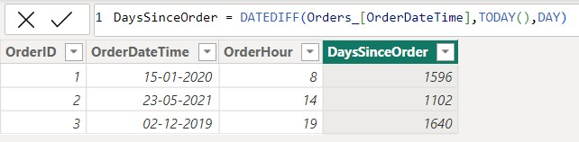
TODAY
The TODAY function in DAX returns the current date. It does not include the time component, only the date.
Syntax
TODAY()
Here just i’m taking for example to understand.
Assume you have a table named Orders with the following columns:
OrderID: The unique identifier for each order.
OrderDate: The date when the order was placed.
Easy dax
Example
How can you create a calculated column in the Sales table that shows the number of days since the order was placed using DAX?
Orders[OrderDate]: The start date for the calculation.
TODAY(): The end date for the calculation, which is the current date.
Use the TODAY function in combination with the DATEDIFF function to calculate the number of days between the OrderDate and the current date. This is useful for tracking the age of
orders.
DAY: Specifies that the difference should be calculated in days.

Slide 6
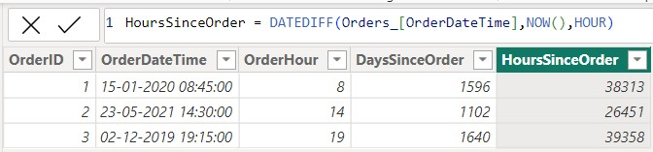
NOW
The NOW function in DAX returns the current date and time. This function includes both the date and the time components.
Syntax
NOW()
Here just i’m taking for example to understand.
Assume you have a table named Orders with the following columns:
OrderID: The unique identifier for each order.
OrderDate: The date when the order was placed.
Understood?
Example
You can create a calculated column to find the number of hours since the order was placed using the NOW function and the DATEDIFF function:
Orders[OrderDateTime]: The start date-time for the calculation.
NOW(): The end date- time for the calculation, which is the current date and time.
Use the NOW function in combination with the DATEDIFF function to calculate the number of hours between the OrderDateTime and the current date and time. This is useful for tracking how many
hours have passed since each order was placed.
HOUR: Specifies that the difference should be calculated in hours.

Slide 7


Thank you for joining me today to learn about Part -44 of Power BI!
Remember, Learning DAX is key to unlocking the full potential of Power BI for insightful reporting and visualization.
Stay tuned for more insights and tips on Power BI in our next Series.
Follow

